Slide 1
Spring 2017 data analysis

Slide 2
Research Question
What are the joint effects of performance and solution transparency on the innovation outcome?

Slide 3
Hypotheses [ this is to be improved based on theory ]
Full transparency has the highest innovation performance compared to all 3 of the other treatment groups
Full transparency has the highest effort compared to all 3 of the other treatment groups
Full transparency has a higher total score of the apps being clicked across all phases compared to solution transparency
Full transparency has a higher number of clicks assigned to an app compared to solution transparency
Full transparency has a higher number of clicks done by a person compared to solution transparency

Slide 4
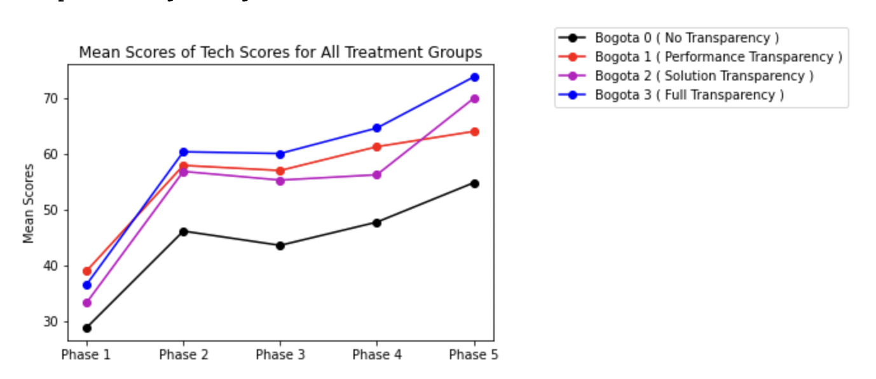
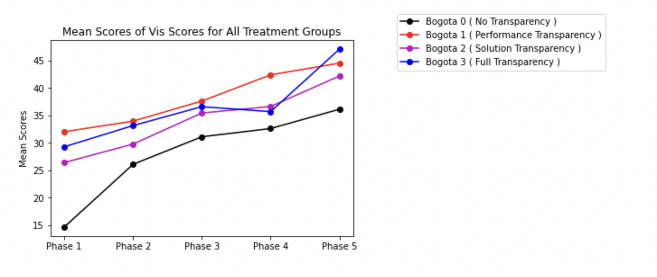
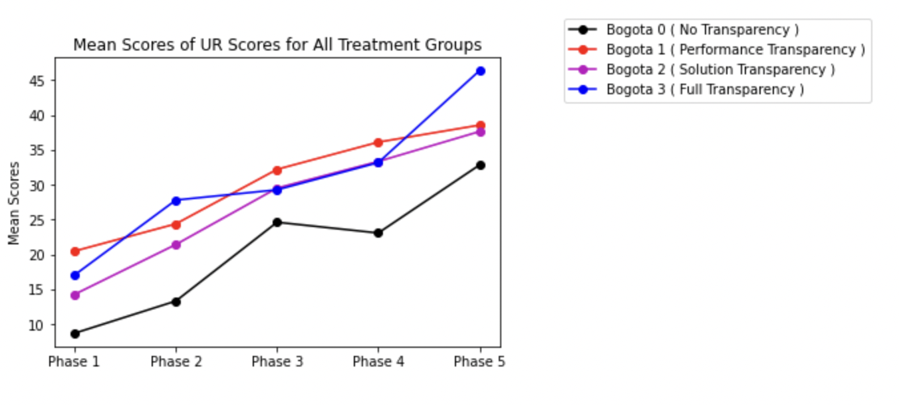
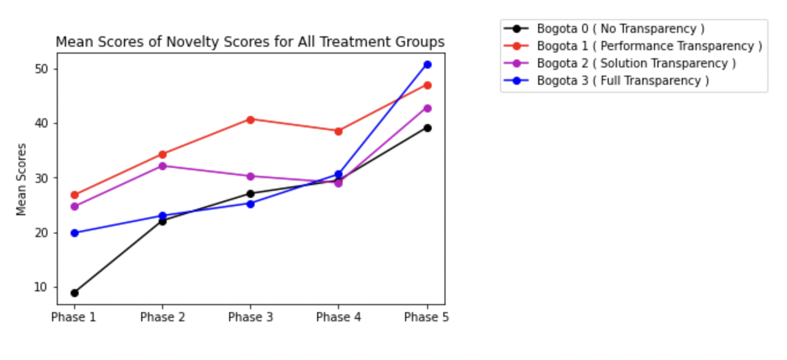
Line Plot of scores in 4 dimensions
Ref Link to Notebook - https://github.com/ironhacks/analysis-2017/blob/main/spring-2017/script/analysis/BoxPlots-LineCharts-BarCharts(Scores%2CLOC%2CD3%2CSurvey).ipynb

Slide 5
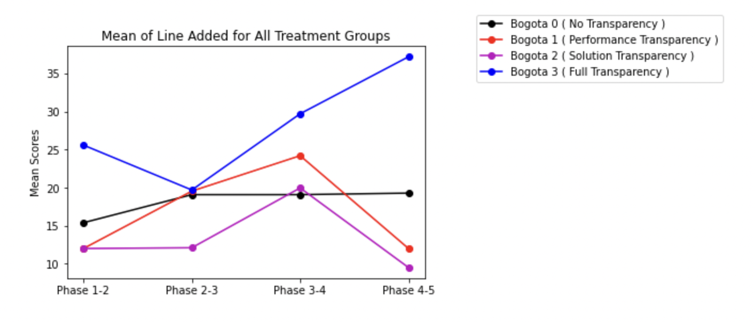
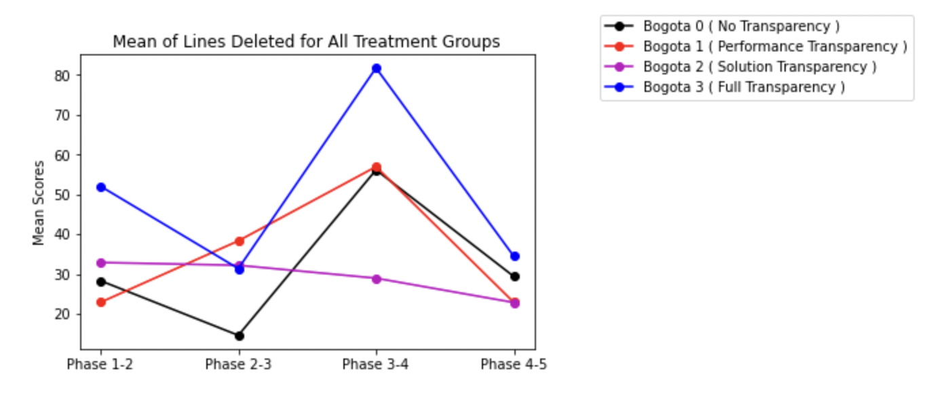
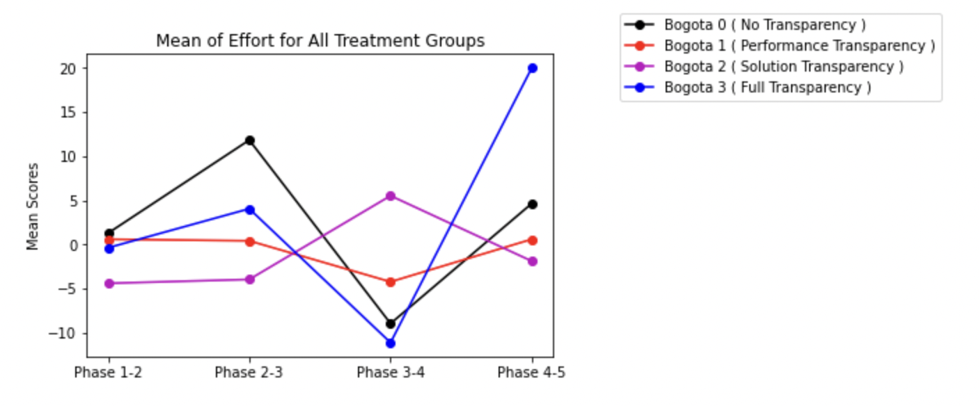
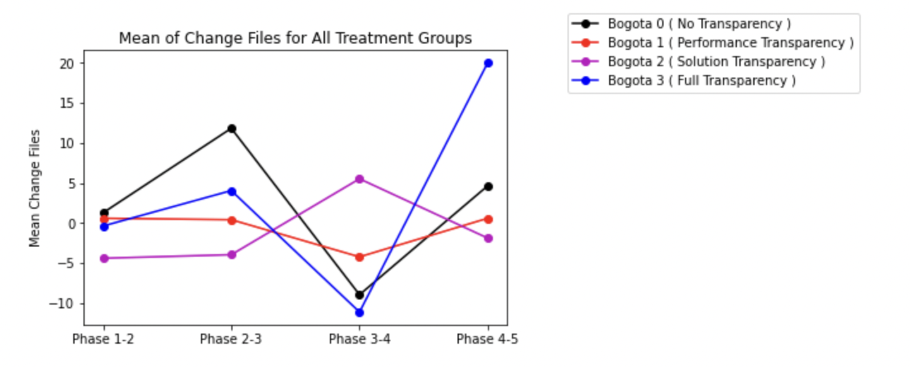
Lines added/deleted/effort/files change
Ref Link to Notebook - https://github.com/ironhacks/analysis-2017/blob/main/spring-2017/script/analysis/BoxPlots-LineCharts-BarCharts(Scores%2CLOC%2CD3%2CSurvey).ipynb

Slide 6
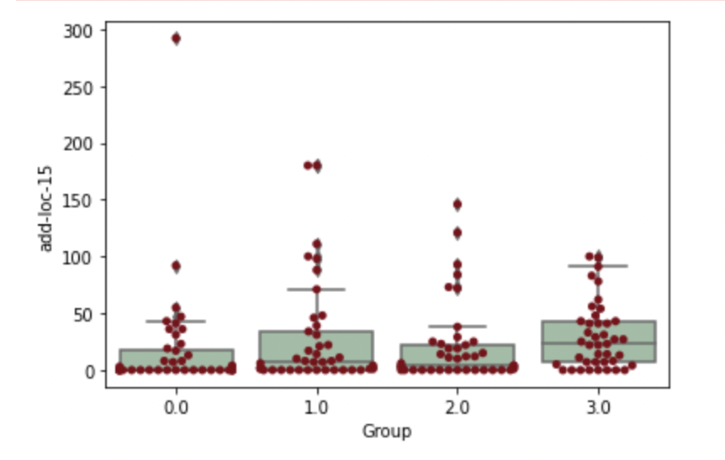
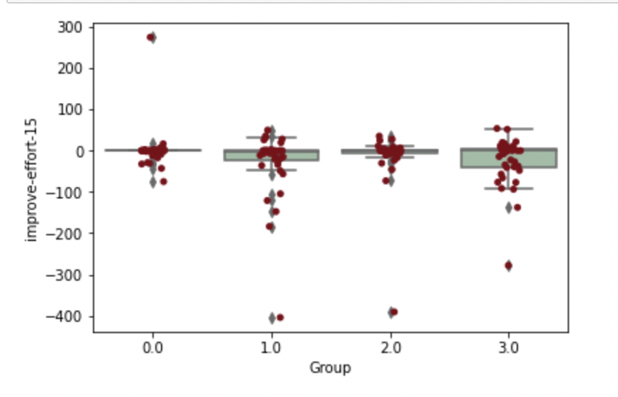
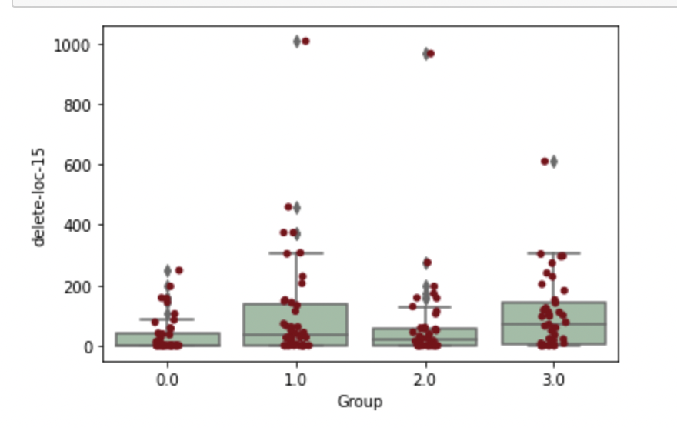
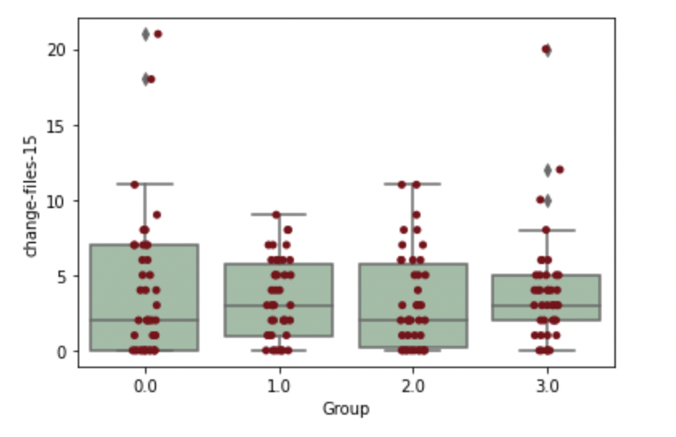
Median Lines added/deleted/effort/files change

Slide 7
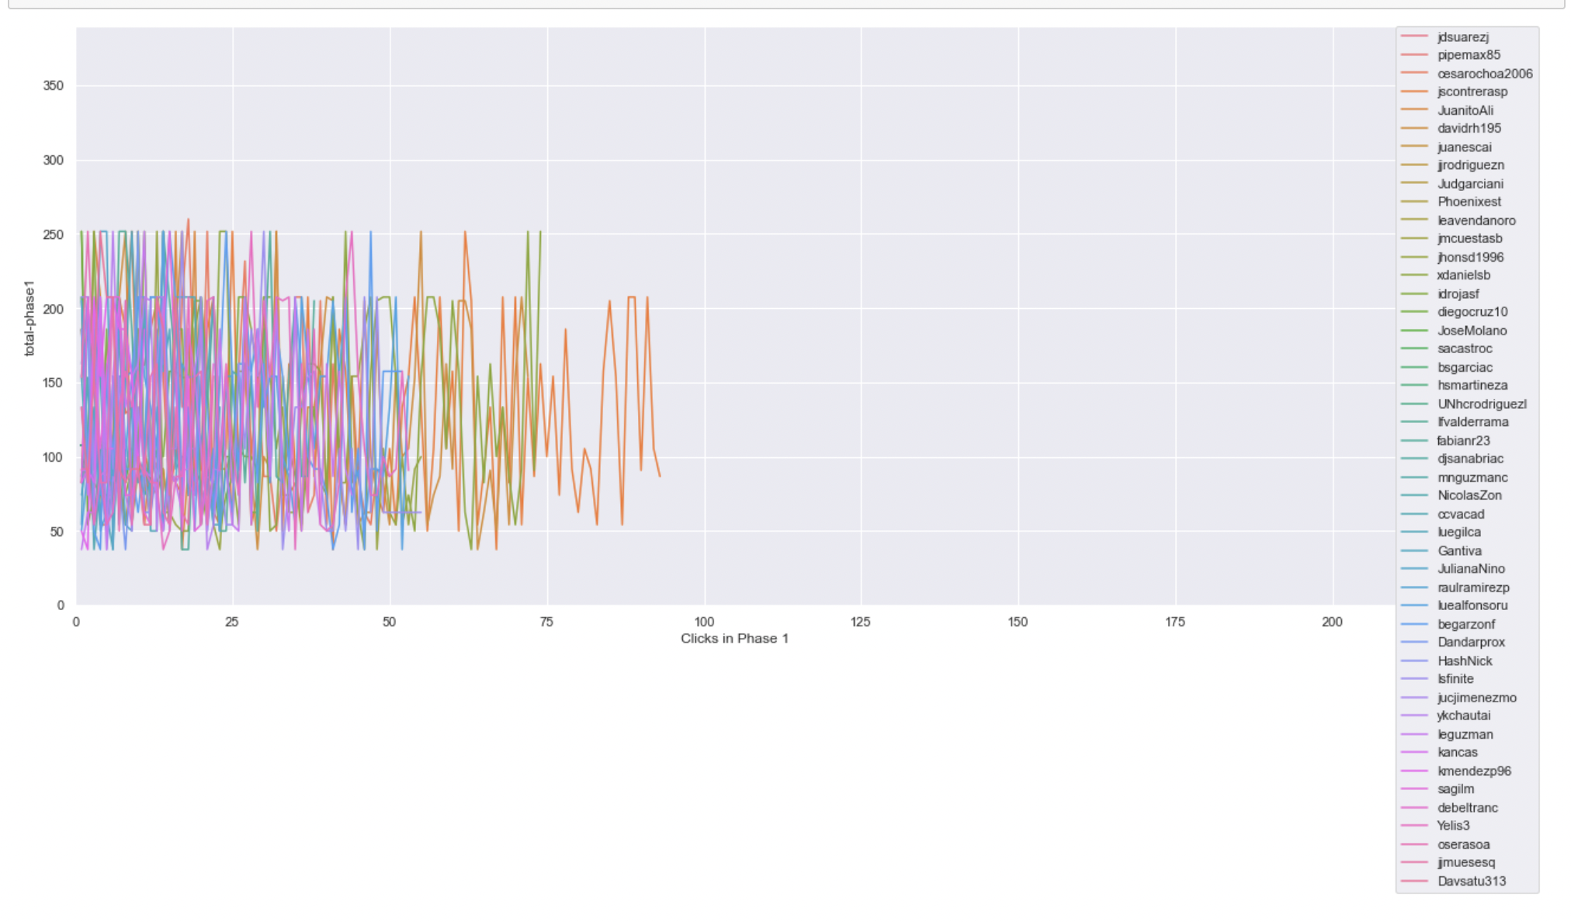
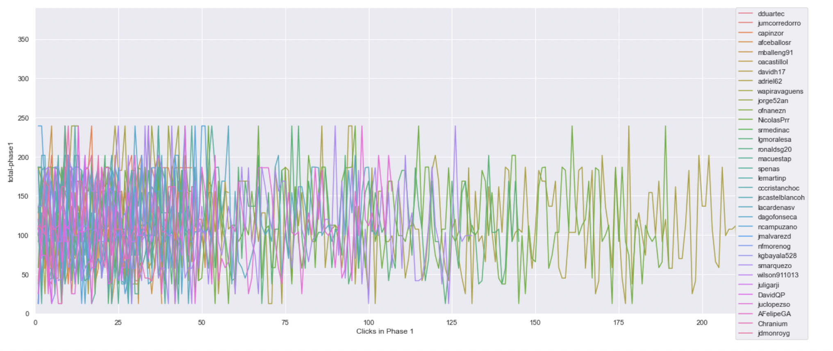
Timeline plot of scores of projects clicked on in phase 1 ( same scale )
Ref Link - https://github.com/ironhacks/analysis-2017/blob/main/spring-2017/script/analysis/Clicks-Analysis(Graphs%2CDescriptive-Analysis).ipynb
Bogota 2 ( Solution Transparency Only ) | Bogota 3 ( Full Transparency )

Slide 8
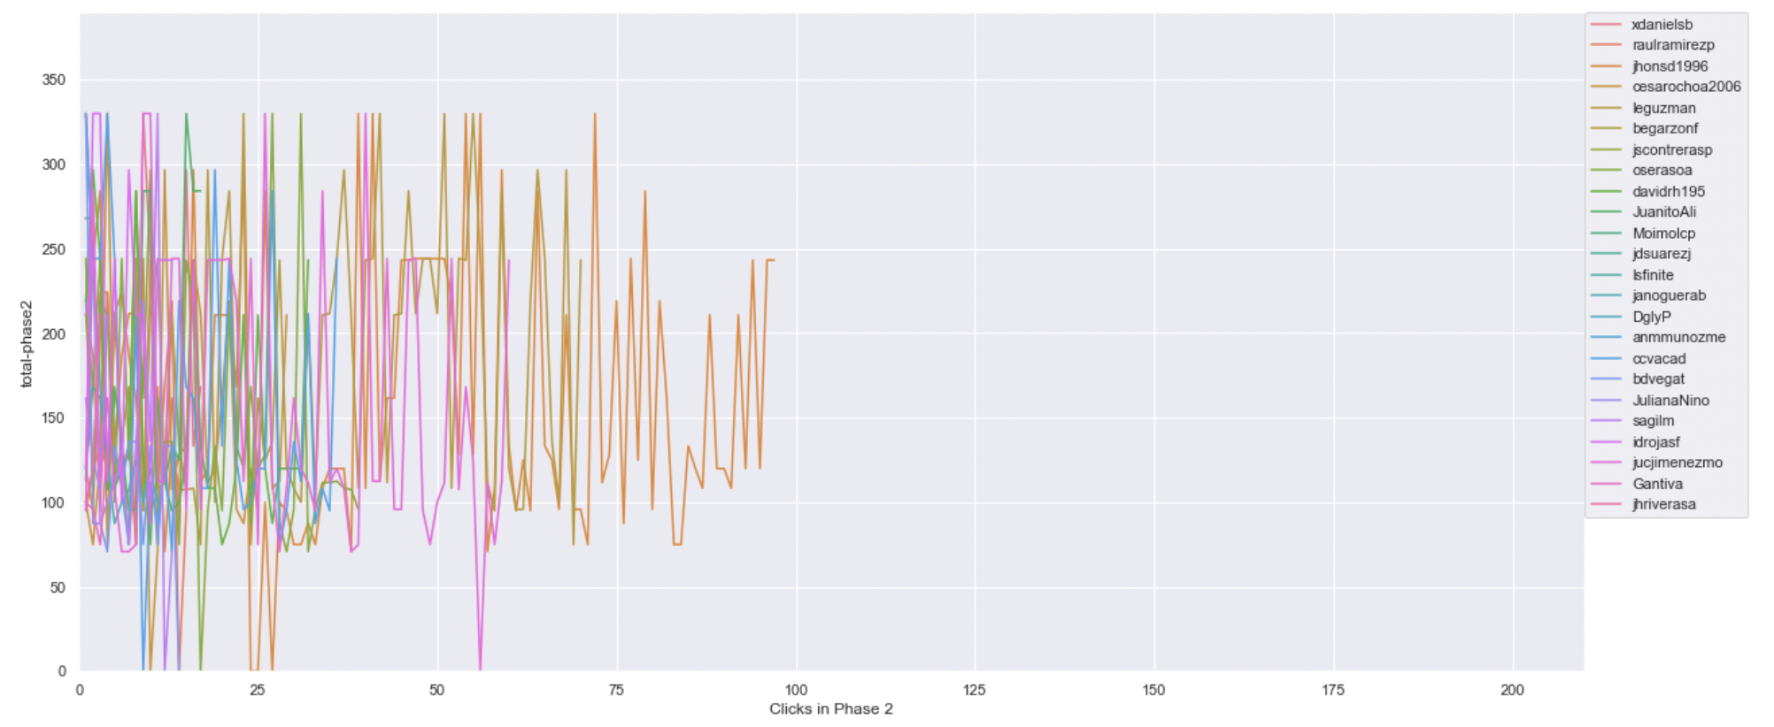
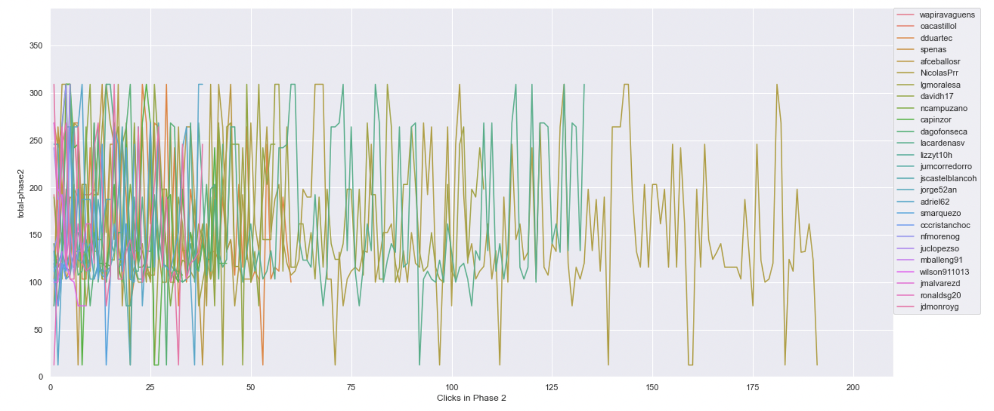
Timeline plot of scores of projects clicked on in phase 2 ( same scale )
Ref Link - https://github.com/ironhacks/analysis-2017/blob/main/spring-2017/script/analysis/Clicks-Analysis(Graphs%2CDescriptive-Analysis).ipynb
Bogota 2 ( Solution Transparency Only ) | Bogota 3 ( Full Transparency )

Slide 9
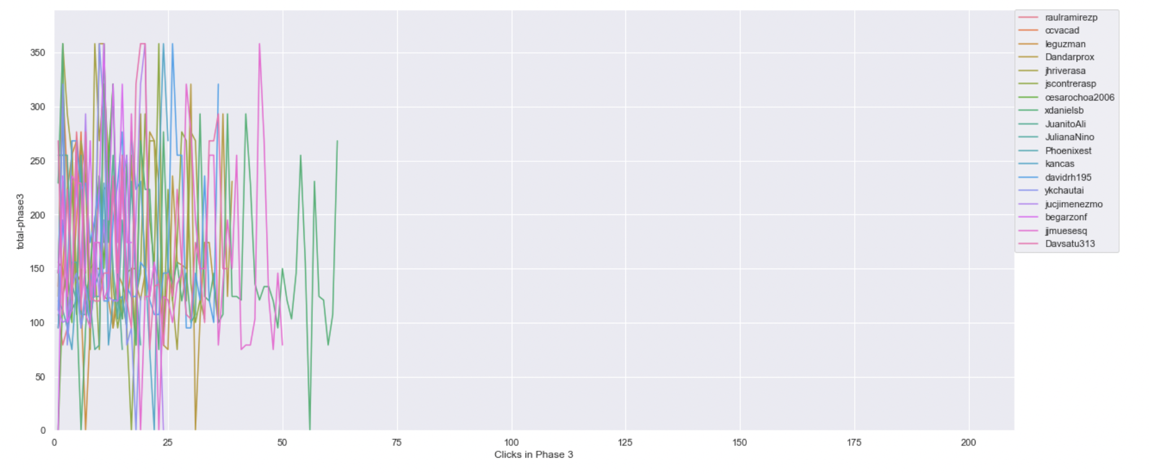
Timeline plot of scores of projects clicked on in phase 3 ( same scale )
Ref Link - https://github.com/ironhacks/analysis-2017/blob/main/spring-2017/script/analysis/Clicks-Analysis(Graphs%2CDescriptive-Analysis).ipynb
Bogota 2 ( Solution Transparency Only ) | Bogota 3 ( Full Transparency )

Slide 10
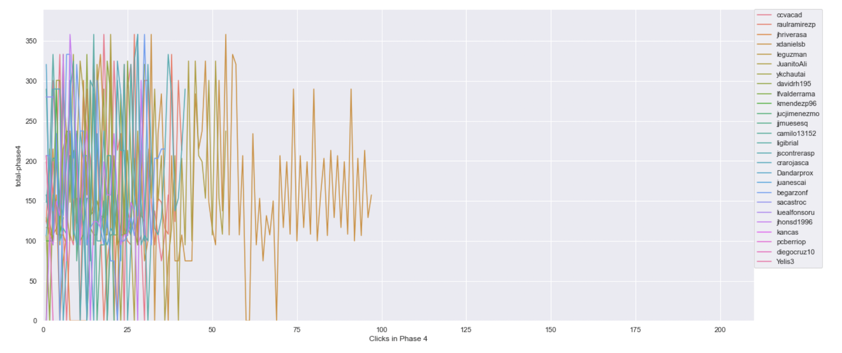
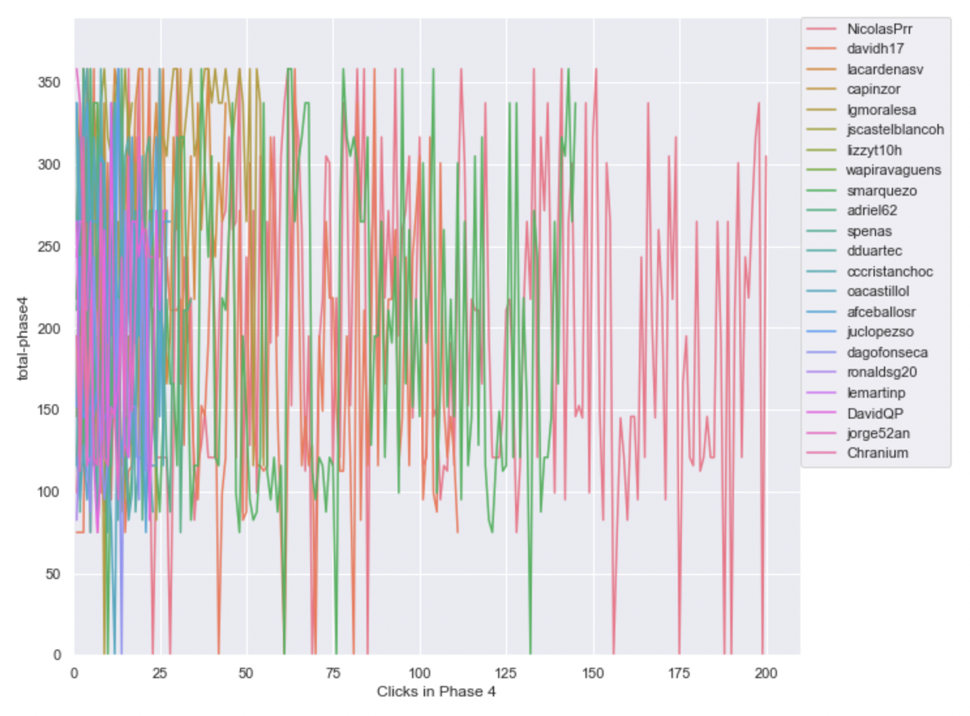
Timeline plot of scores of projects clicked on in phase 4 ( same scale )
Ref Link - https://github.com/ironhacks/analysis-2017/blob/main/spring-2017/script/analysis/Clicks-Analysis(Graphs%2CDescriptive-Analysis).ipynb
Bogota 2 ( Solution Transparency Only ) | Bogota 3 ( Full Transparency )

Slide 11
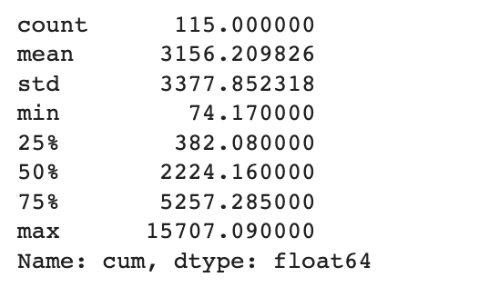
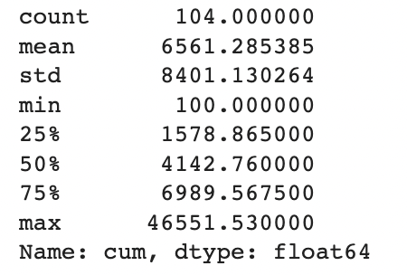
Total Score of the Apps Being Clicked Across All Phases ( Descriptive Analysis )
Ref Link - https://github.com/ironhacks/analysis-2017/blob/main/spring-2017/script/analysis/Clicks-Analysis(Graphs%2CDescriptive-Analysis).ipynb
Bogota 2 ( Solution Transparency ) | Bogota 3 ( Full Transparency )

Slide 12
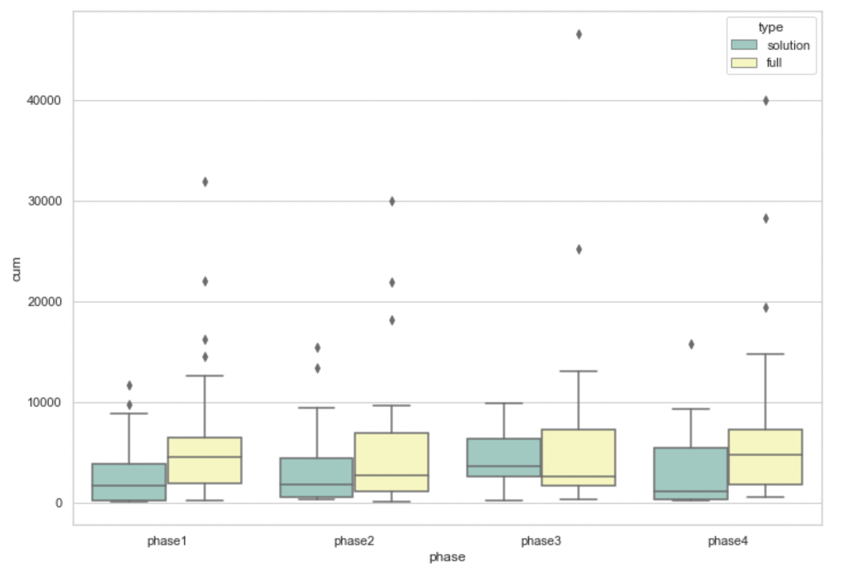
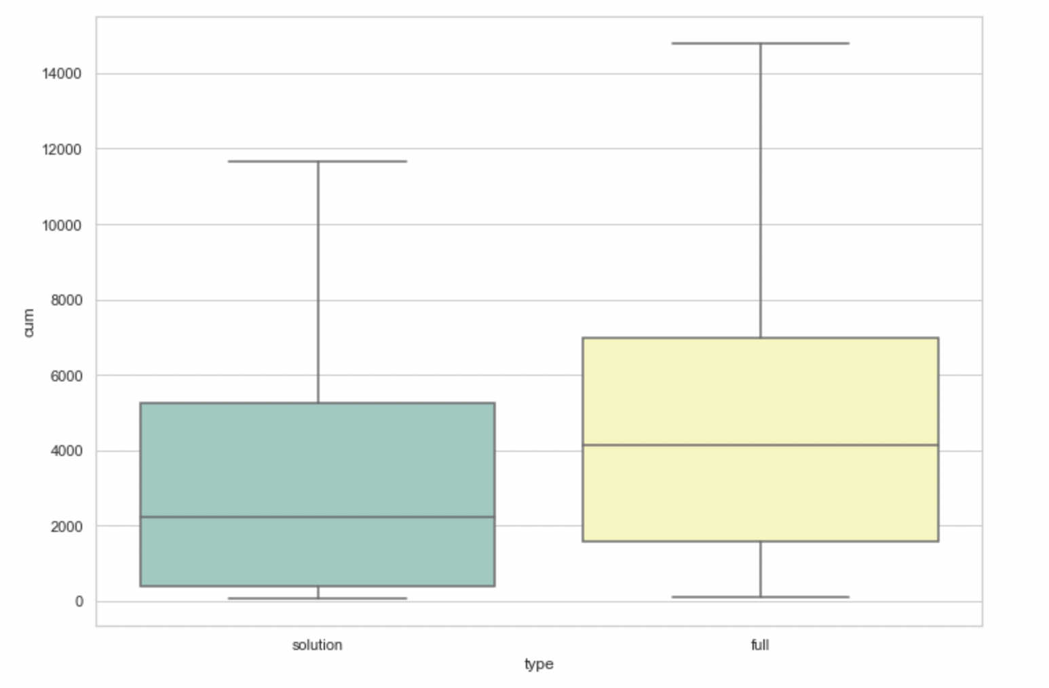
Total Score of the Apps Being Clicked Across All Phases ( box plots )
pvalue=0.00017575311061889564
( Independent T-test )

Slide 13
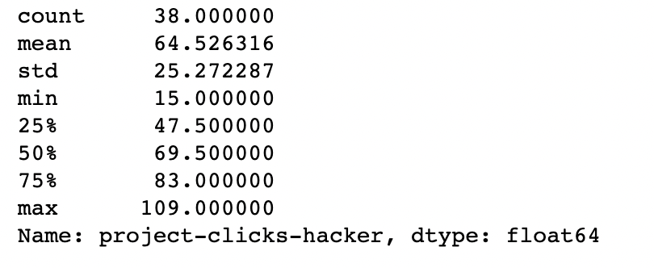
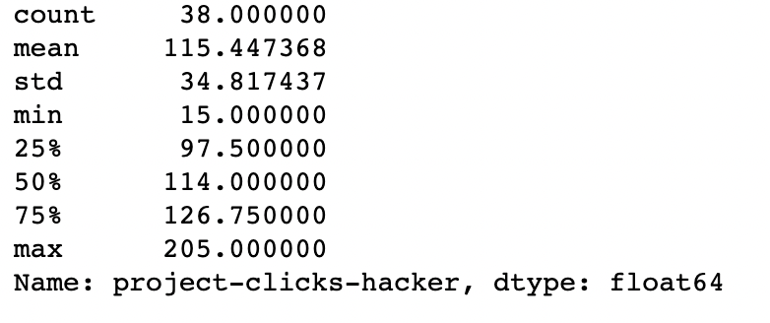
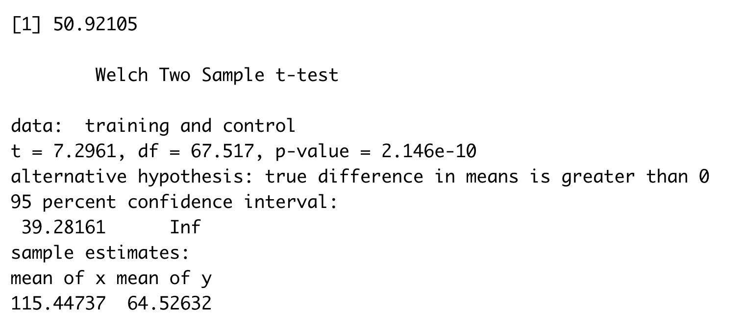
The number of clicks assigned to an app
Bogota 2 ( Solution Transparency ) | Bogota 3 ( Full Transparency )

Slide 14
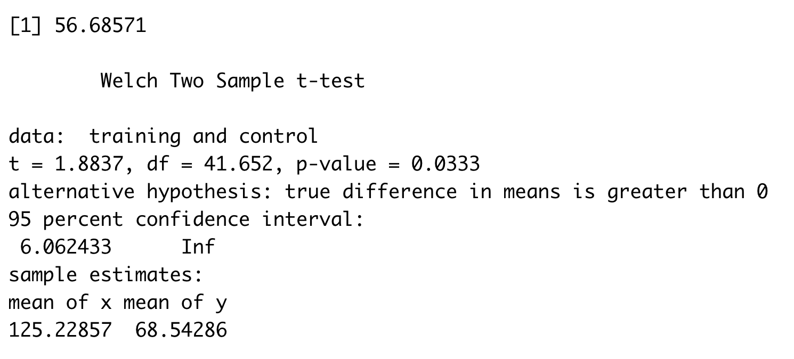
The number of clicks done by a person
Bogota 2 ( Solution Transparency ) | Bogota 3 ( Full Transparency )
Stats for Solution Transparency Min. : 1.00 1st Qu.: 32.00 Median : 55.00 Mean : 68.54 3rd Qu.: 88.00 Max. :250.00 NA's :7 | Stats for Full Transparency Min. : 1.0 1st Qu.: 43.0 Median : 60.0 Mean :125.2 3rd Qu.:128.5 Max. :821.0 NA's :6

Slide 15
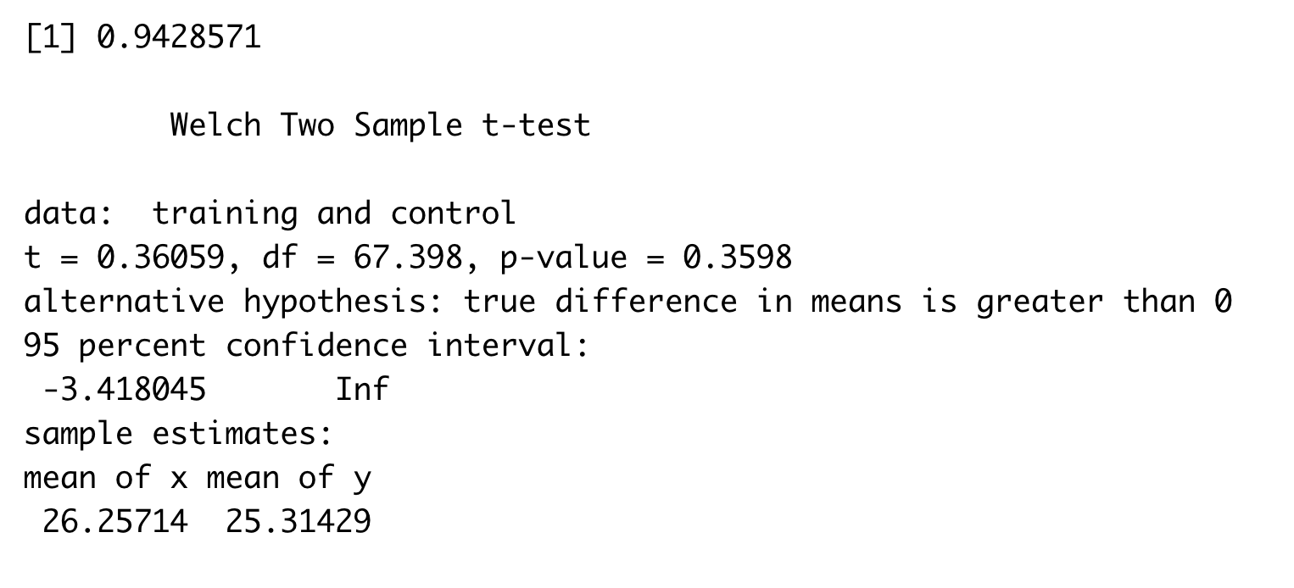
The number of unique apps explored
Bogota 2 ( Solution Transparency ) | Bogota 3 ( Full Transparency )
Stats for Solution Transparency count 35.000000 mean 25.314286 std 10.408626 min 1.000000 25% 20.500000 50% 27.000000 75% 34.500000 max 37.000000 | Stats for Full Transparency count 35.000000 mean 26.257143 std 11.443834 min 1.000000 25% 21.500000 50% 29.000000 75% 36.500000 max 38.000000

Slide 16
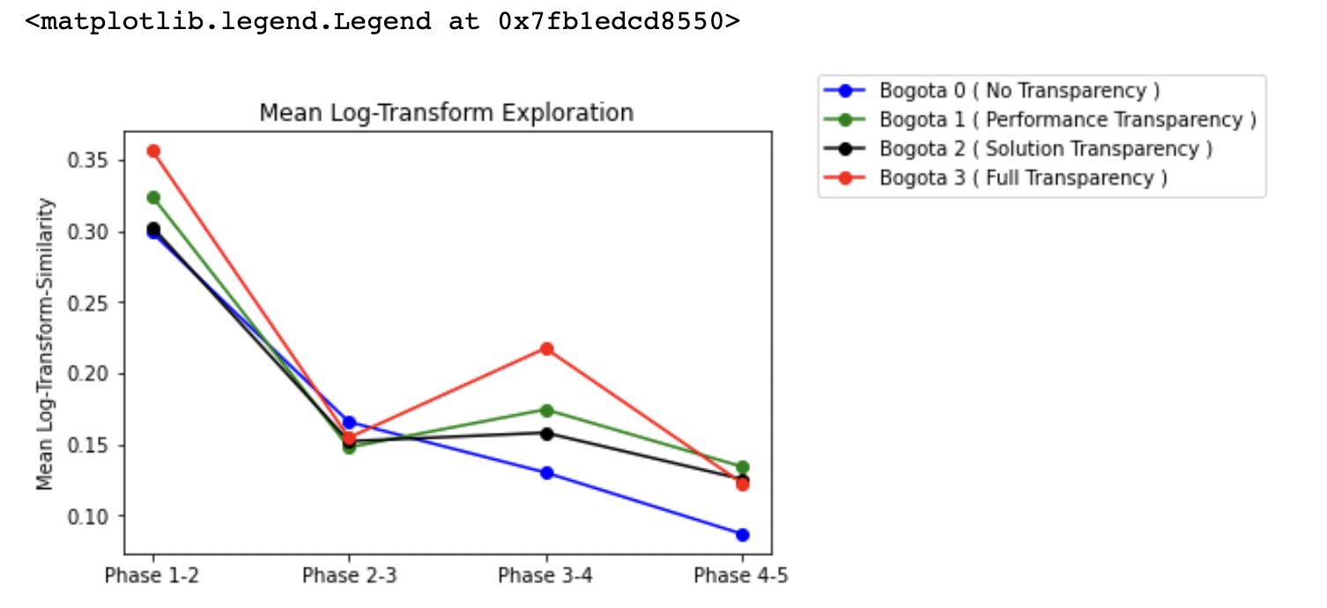
Output from Fuzzy
Individual Exploration Before ( Left ) and After Fuzzy ( Right )

Slide 17
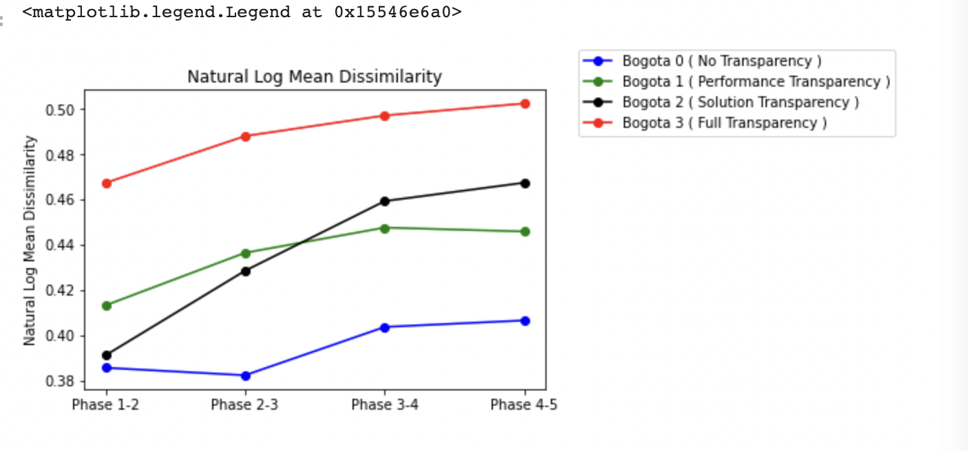
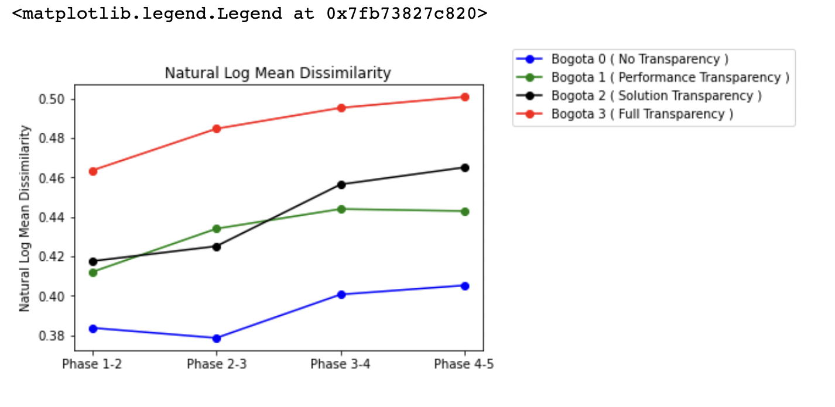
Output from Fuzzy
Dissimilarity Before ( Left ) and After Fuzzy ( Right )
Interpretation: Novelty highest in full transparency case.

Slide 18
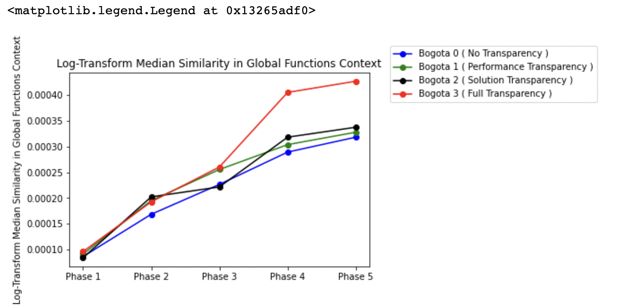
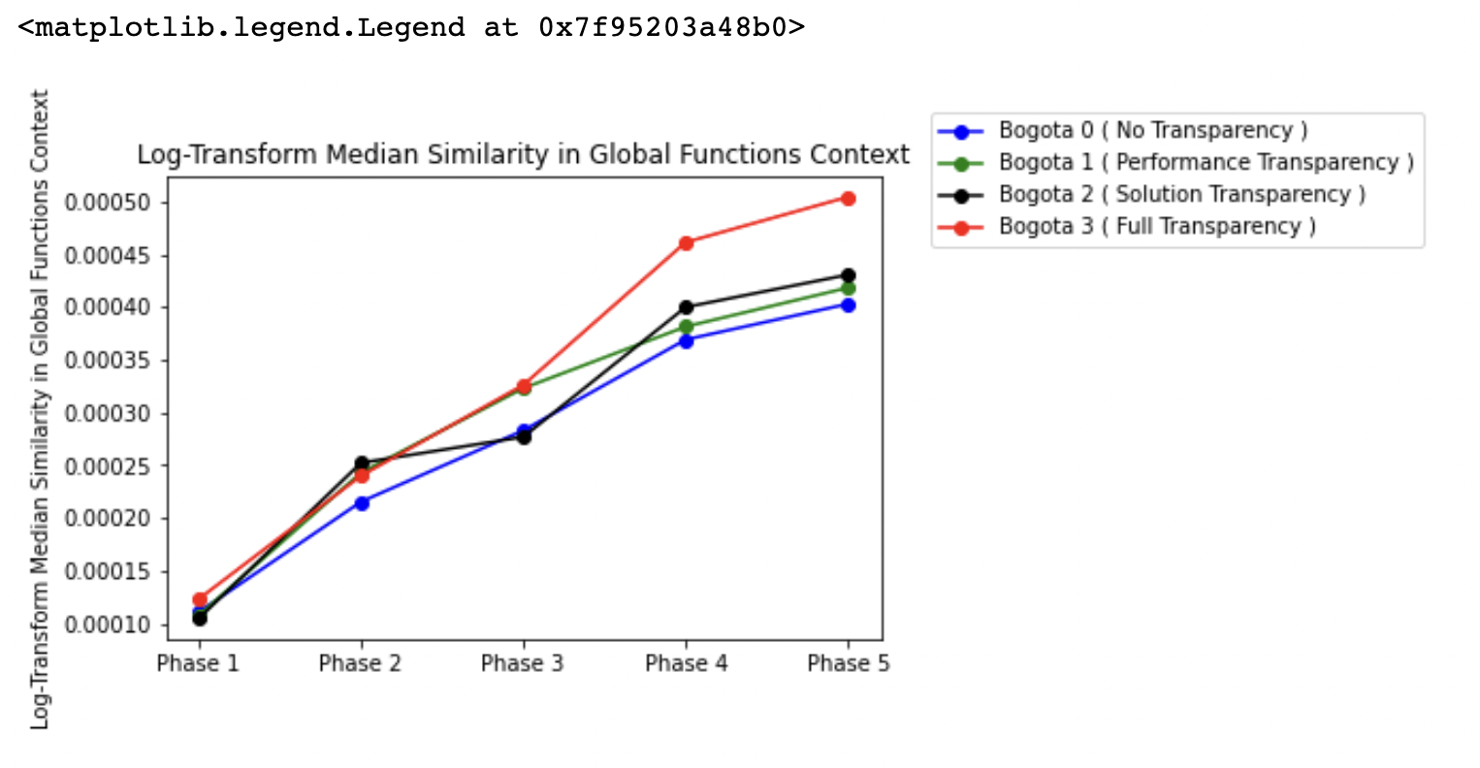
Output from Fuzzy Median Similarity in Global Functions Context Before ( Left ) and After Fuzzy ( Right )
Interpretation: A lot of functions in the global pool come from full transparency case.

Slide 19
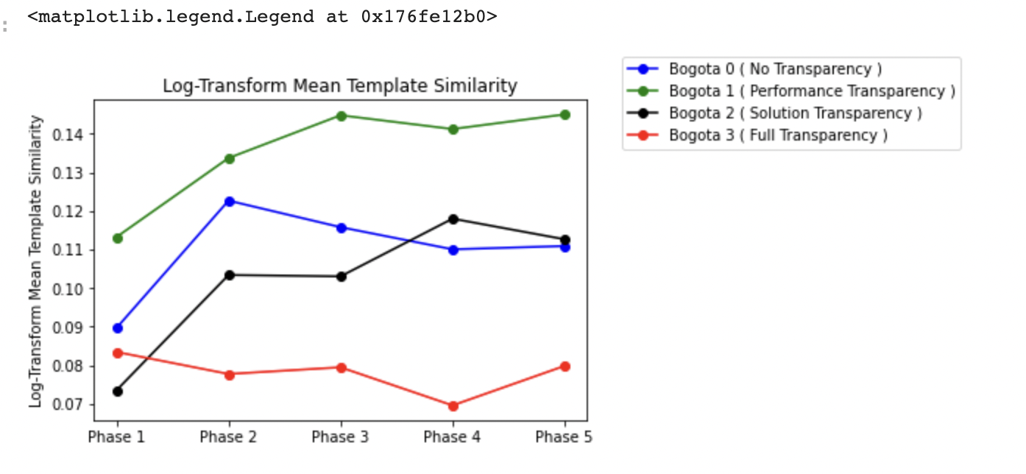
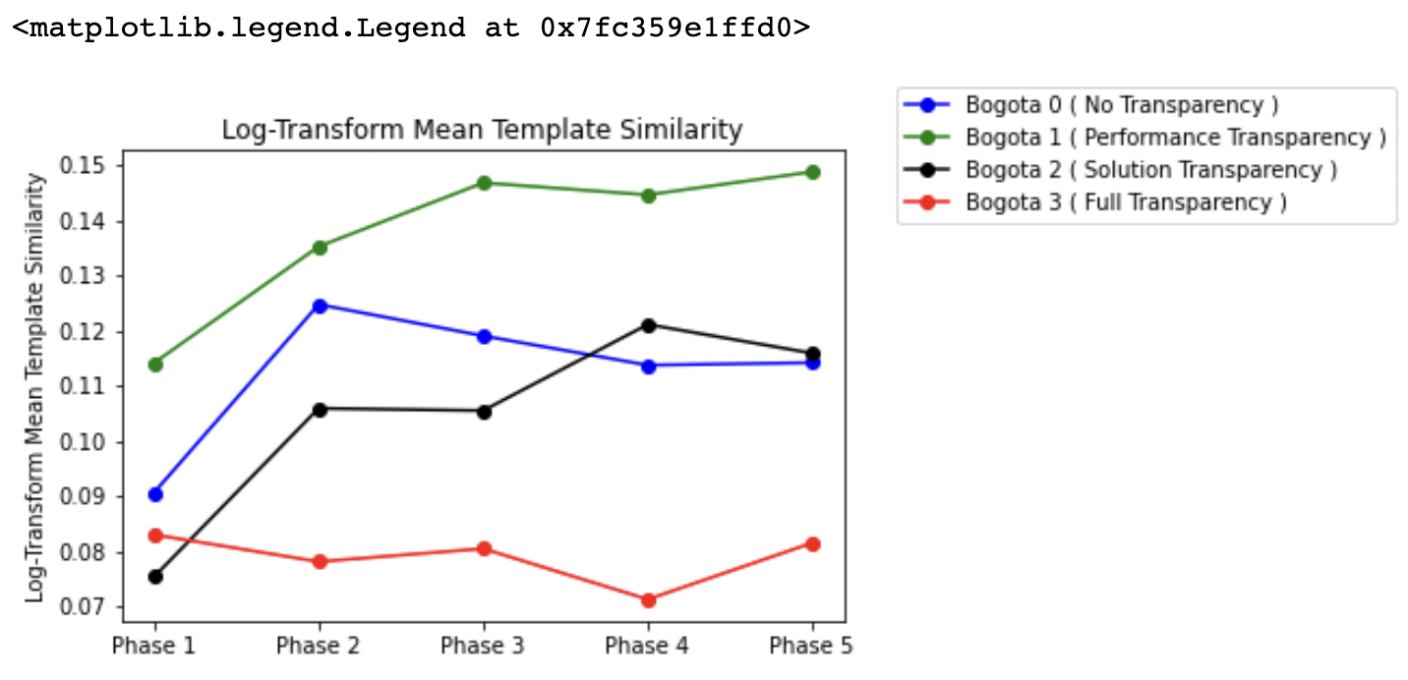
Output from Fuzzy Mean Similarity in Template Functions Context Before ( Left ) and After Fuzzy ( Right )

Slide 20
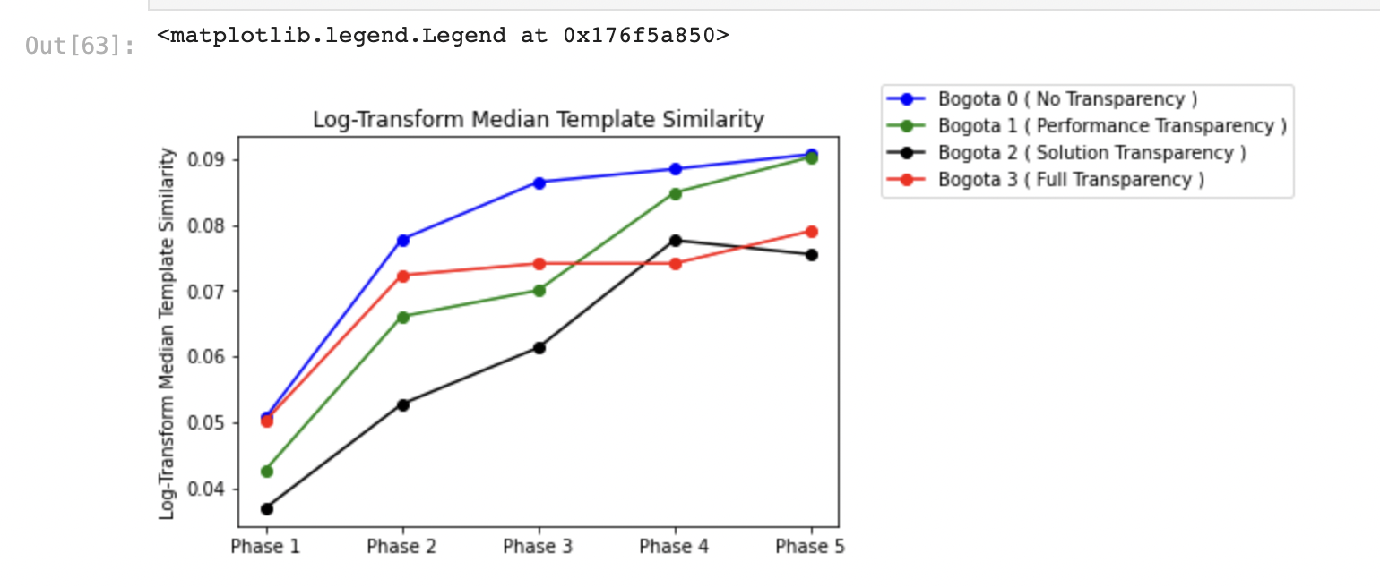
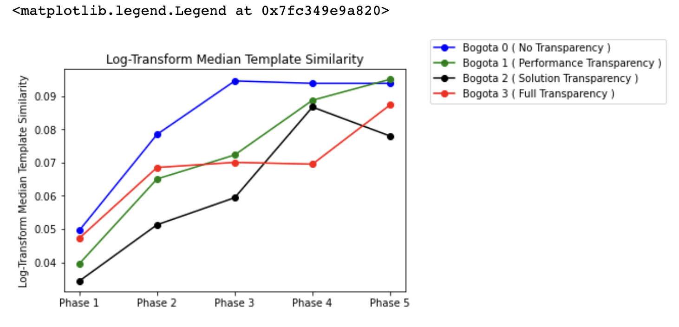
Output from Fuzzy Median Similarity in Template Functions Context Before ( Left ) and After Fuzzy ( Right )

Slide 21
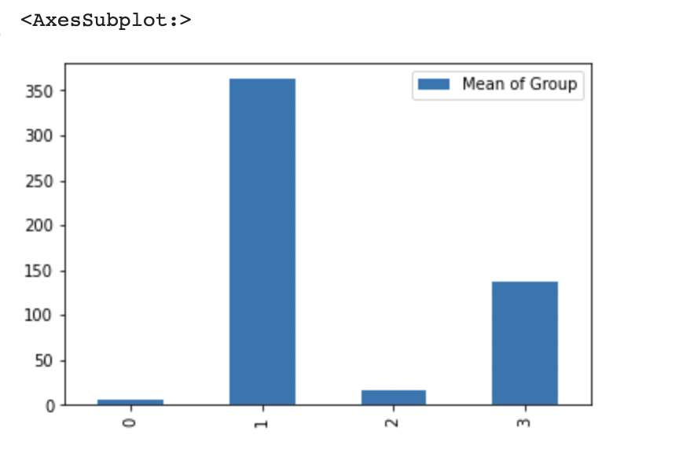
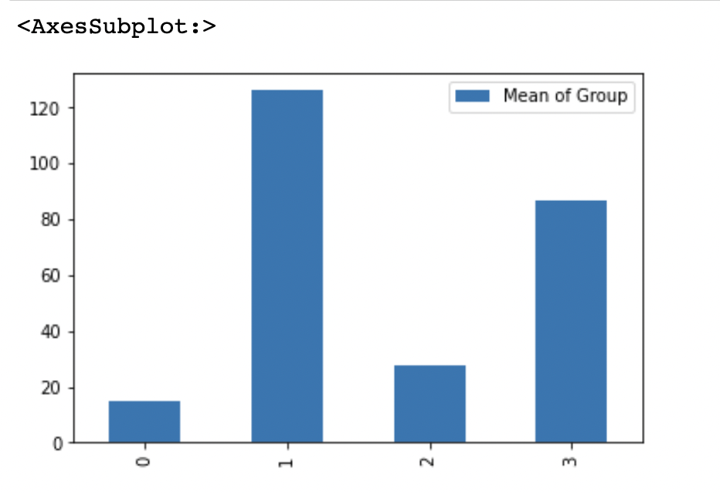
Output from Fuzzy Distributions in Top 10% Rare Functions (functions level) Before ( Left ) and After Fuzzy ( Right )

Slide 22
Output from Fuzzy Distributions in Top 10% Rare Functions (Individual level ) Before ( Left ) and After Fuzzy ( Right )

Slide 23
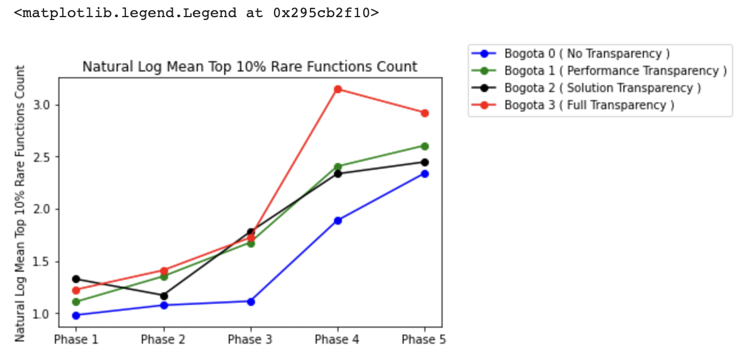
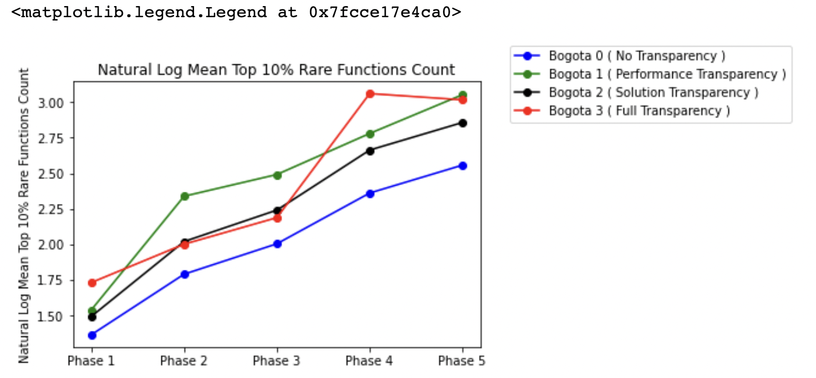
Output from Fuzzy Distributions in Top 10% Rare Functions (Individual level ) Before ( Left ) and After Fuzzy ( Right )

Slide 24
Cross stage similarity metrics on an individual level (Variable Name: individual_exploration (IND_EXP))

Slide 25
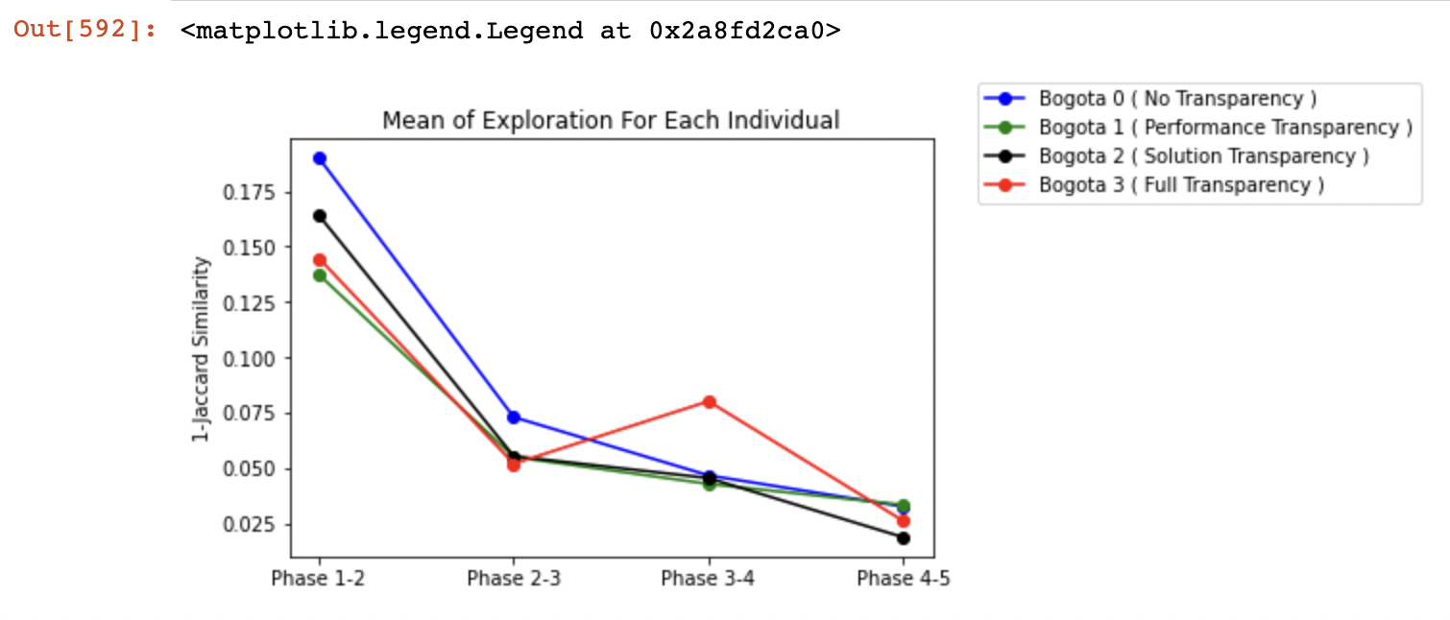
Mean Individual Exploration [ Prior Log-Transform ]

Slide 26
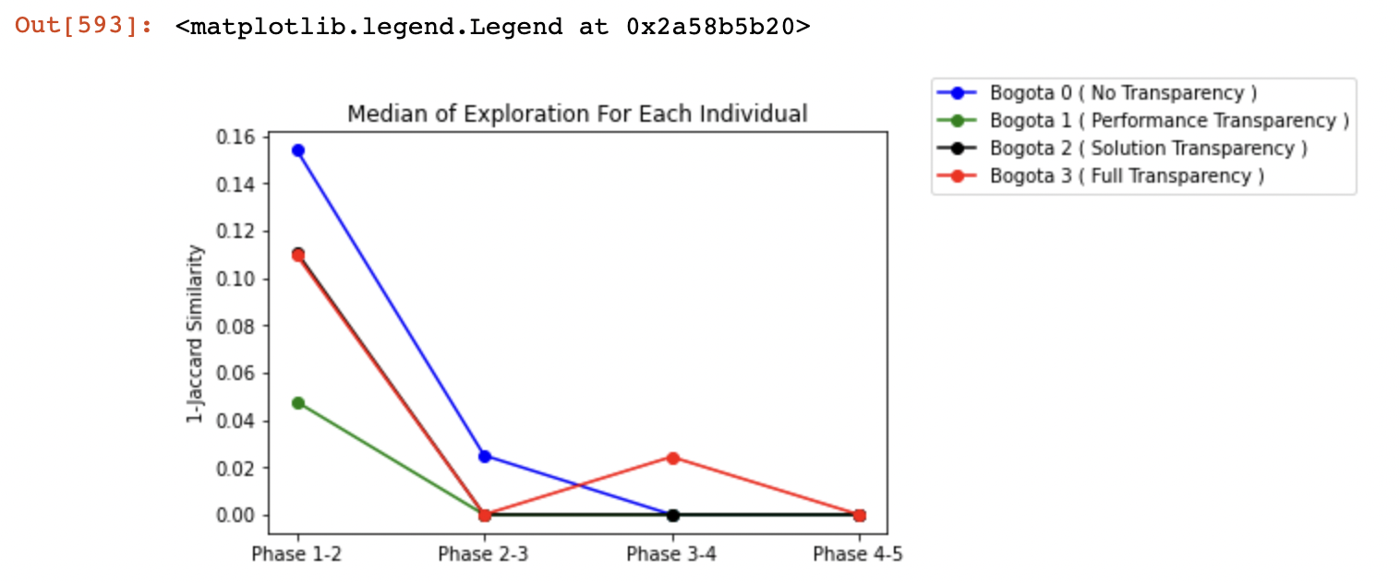
Median Individual Exploration [ Prior Log-Transform ]

Slide 27
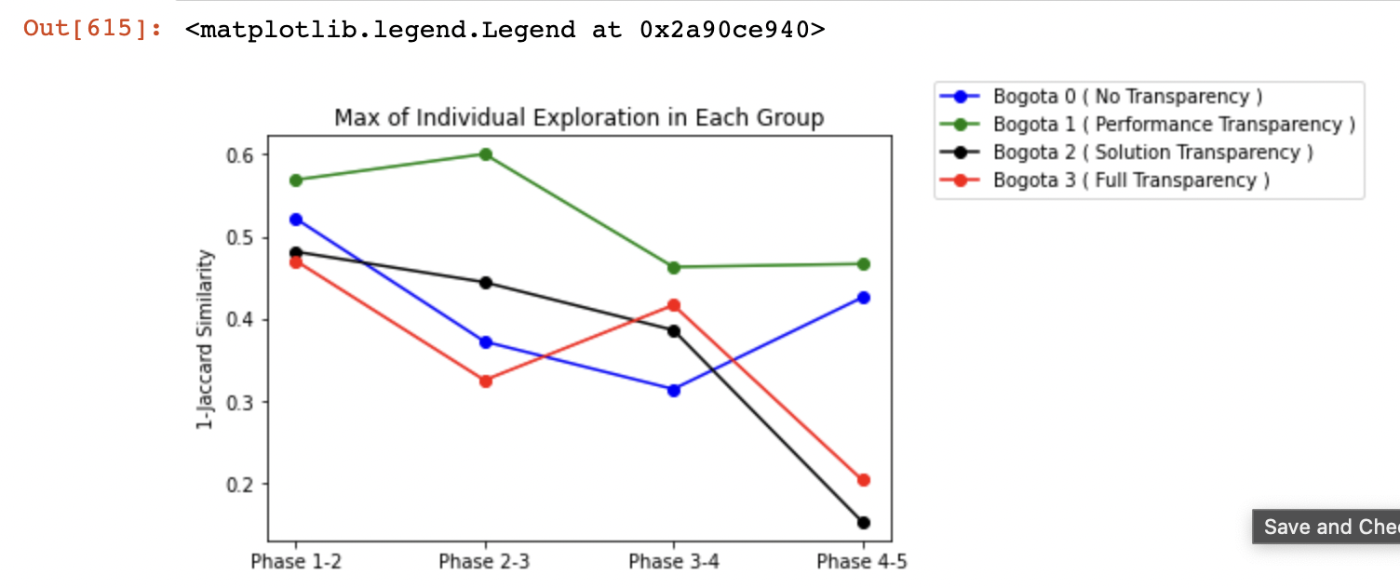
Max Individual Exploration [ Prior Log-Transform ]

Slide 31
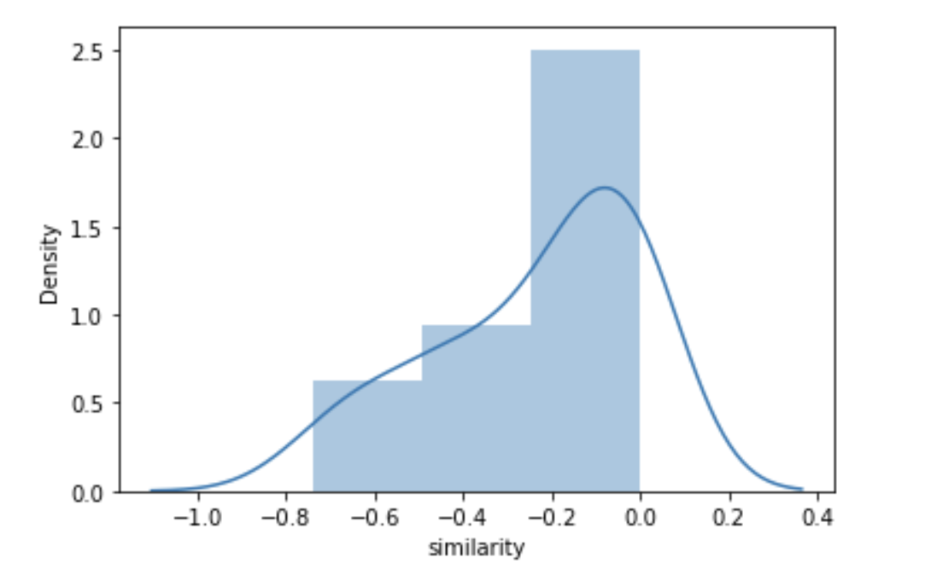
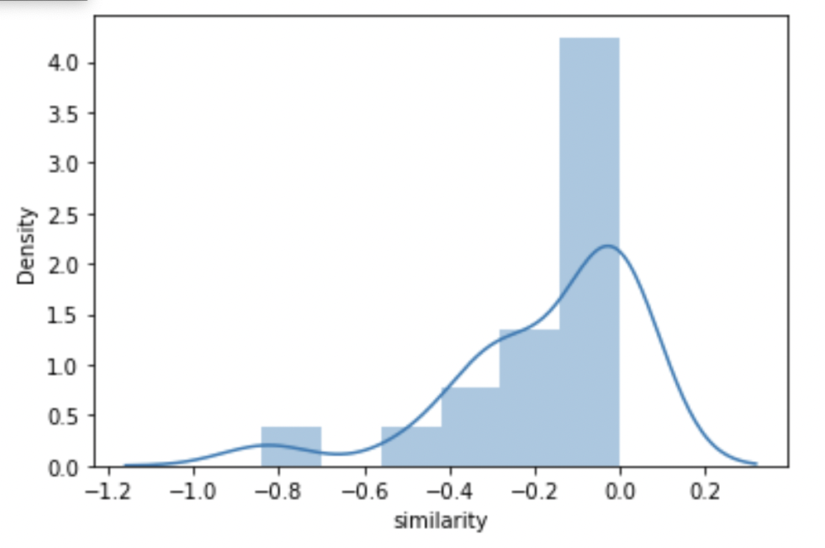
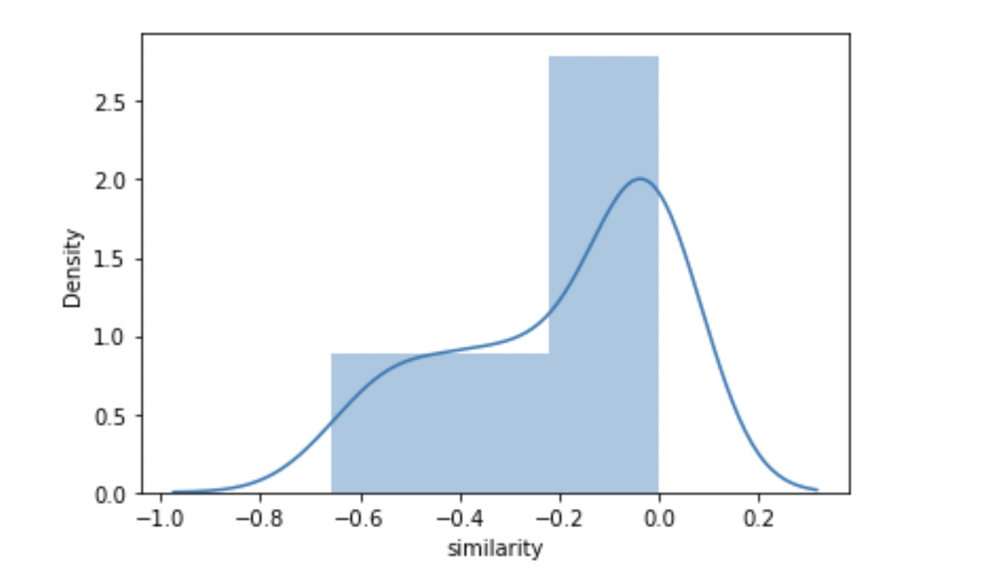
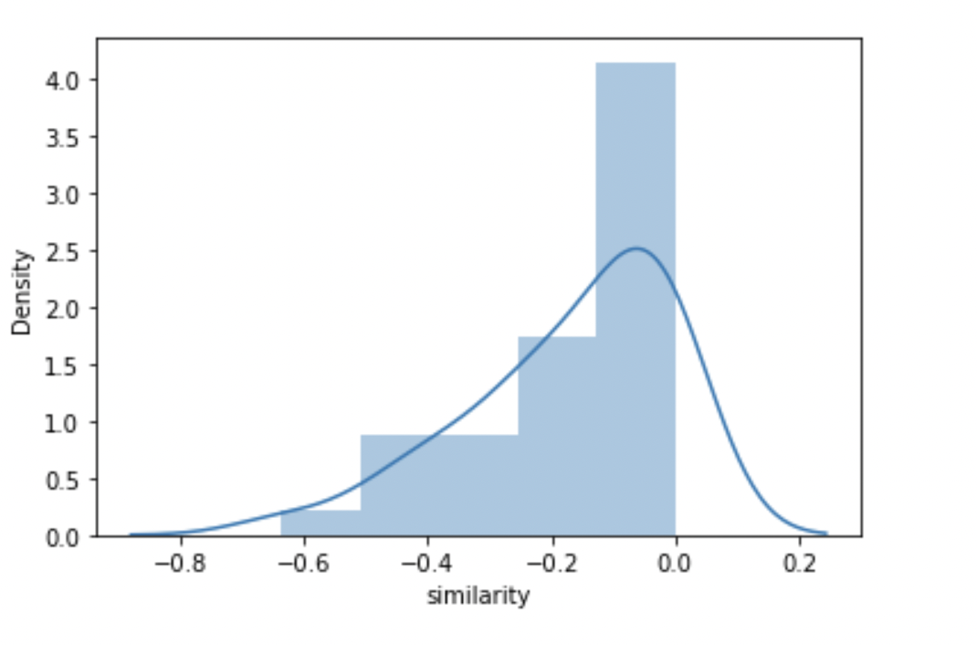
Phase 1-2 After Natural Log Transformation
Bogota 0 | Bogota 1
Bogota 2 | Bogota 3

Slide 32
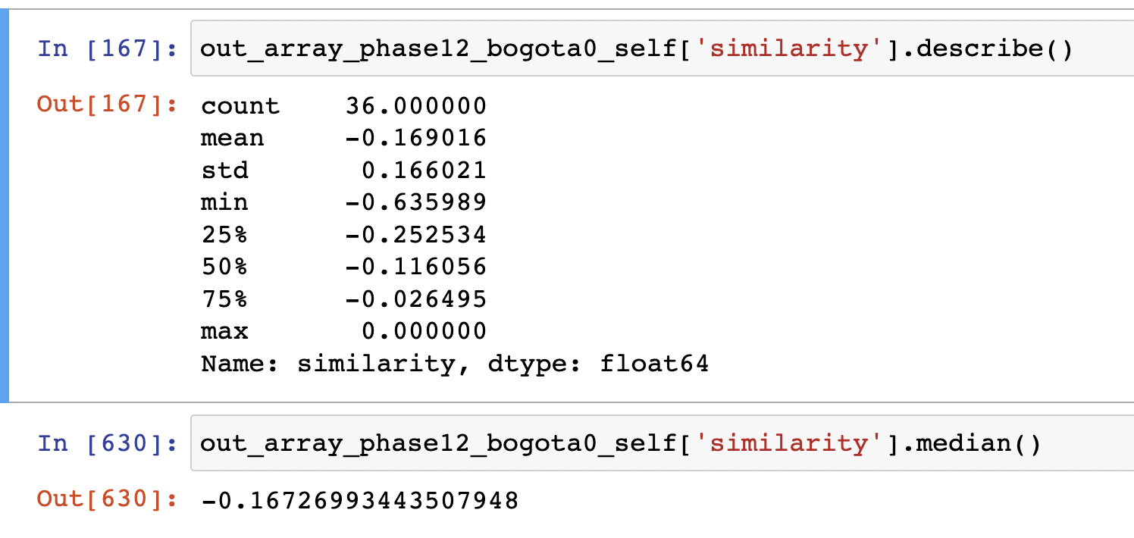
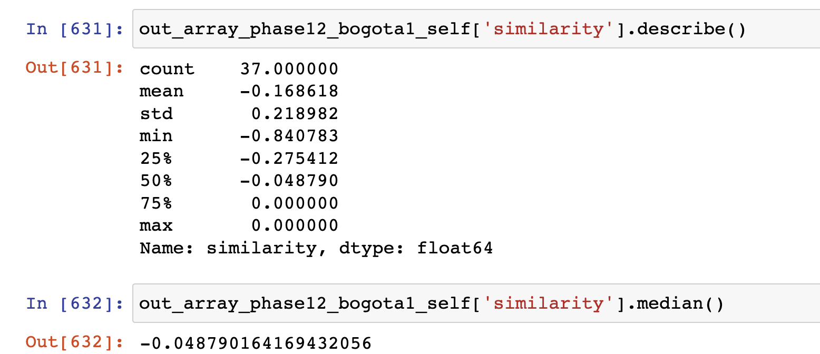


Phase 1-2 After Natural Log Transformation
Bogota 0 | Bogota 1
Bogota 2 | Bogota 3

Slide 33




Phase 2-3 After Natural Log Transformation
Bogota 0 | Bogota 1
Bogota 2 | Bogota 3

Slide 34




Phase 2-3 After Natural Log Transformation
Bogota 0 | Bogota 1
Bogota 2 | Bogota 3

Slide 35




Phase 3-4 After Natural Log Transformation
Bogota 0 | Bogota 1
Bogota 2 | Bogota 3

Slide 36




Phase 3-4 After Natural Log Transformation
Bogota 0 | Bogota 1
Bogota 2 | Bogota 3

Slide 37




Phase 4-5 After Natural Log Transformation
Bogota 0 | Bogota 1
Bogota 2 | Bogota 3

Slide 38




Phase 4-5 After Natural Log Transformation
Bogota 0 | Bogota 1
Bogota 2 | Bogota 3

Slide 39


Total Count of Functions for Each Group

Slide 40


Total Unique Functions for Each Group

Slide 41

Median Count of Template Functions Per Individual

Slide 42

Median Template Similarity

Slide 43

Mean Count of Template Functions Per Individual

Slide 44

Mean Template Similarity

Slide 45


Distribution Plot of Template Functions Per Individual
Phase 1 | Phase 2

Slide 46


Distribution Plot of Template Functions Per Individual

Slide 47

Distribution Plot of Template Functions Per Individual

Slide 48

Median Functions Per Individual [ Variety ] [ Repetition Removed ]

Slide 49




Log Transformed Plot for Unique Functions
Bogota 3 | Bogota 2
Bogota 1 | Bogota 0

Slide 50

Median Rare Functions [ 10% Quantile ] [ Functions Level ]

Slide 51

Median Top 10% Rare Functions Per Individual [ Per Phase ]

Slide 52


Mean/Median Rare Functions [ 10% Quantile ] [ Individual Level ] [ Overall Case ]
Mean
Median

Slide 53


Mean/Median Rare Functions [ 20% Quantile ] [ Individual Level ] [ Overall Case ]

Slide 54

Distribution of Rare Functions [ 10% ] [ Individual Level ] [ Overall Case ]

Slide 55

Distribution of Rare Functions [ 20% ] [ Individual Level ] [ Overall Case ]

Slide 56

Phase 1 Error Bar for 10% Quantile

Slide 57

Phase 1 Boxplot for 10% Quantile
Extreme outliers
Potential Outliers

Slide 58

Phase 2 Error Bar for 10% Quantile

Slide 59

Phase 2 Boxplot for 10% Quantile
All outliers in this plot are ”extreme” outliers.

Slide 60

Phase 3 Error Bar for 10% Quantile

Slide 61

Phase 3 Boxplot for 10% Quantile
Extreme
Outliers
Potential Outliers

Slide 62

Phase 4 Boxplot for 10% Quantile

Slide 63

Phase 4 Error Bar for 10% Quantile
Extreme outliers
Potential outliers

Slide 64

Phase 5 Boxplot for 10% Quantile

Slide 65

Phase 5 Error Bar for 10% Quantile

Slide 66
Phase 1 Outliers [ Variety Unique Functions ] [ Repetition Removed ] [ Individual ]
Bogota 0 | Bogota 1 | Bogota 2 | Bogota 3
100 < X < 200 Count = 1 | 100 < X < 200 Count = 4 | 100 < X < 200 Count = 1 | 100 < X < 200 Count = 2
 | 200 < X < 300 Count = 1 | 500 < X < 600 Count = 1 | 30,000 < X < 40,000 Count = 1
 | 300 < X < 400 Count = 1 | 30,000 < X < 40,000 Count = 1 | 70,000 < X < 80,000 Count = 1

Slide 67
Phase 2 Outliers [ Variety Unique Functions ] [ Repetition Removed ] [ Individual ]
Bogota 0 | Bogota 1 | Bogota 2 | Bogota 3
100 < X < 200 Count = 1 | 100 < X < 200 Count = 6 | 100 < X < 200 Count = 3 | 100 < X < 200 Count = 2
7000 < X < 8000 Count = 1 | 200 < X < 300 Count = 1 | 400 < X < 500 Count = 1 | 300 < X < 400 Count = 1
 | 300 < X < 400 Count = 1 | 500 < X < 600 Count = 1 | 2,000 < X < 3,000 Count = 1
 | 1000 < X < 2000 Count = 1 | 2,000 < X < 3,000 Count = 2 | 30,000 < X < 40,000 Count = 1
 | 2000 < X < 3000 Count = 3 | 3,000 < X < 4,000 Count = 1 | 70,000 < X < 80,000 Count = 1
 | 20,000 < X < 30,000 Count = 1 | 30,000 < X < 40,000 Count = 1
 | 70,000 < X < 80,000 Count = 1

Slide 68
Phase 3 Outliers [ Variety Unique Functions ] [ Repetition Removed ] [ Individual ]
Bogota 0 | Bogota 1 | Bogota 2 | Bogota 3
100 < X < 200 Count = 1 | 100 < X < 200 Count = 6 | 100 < X < 200 Count = 4 | 100 < X < 200 Count = 4
2000 < X < 3000 Count = 1 | 200 < X < 300 Count = 2 | 400 < X < 500 Count = 1 | 200 < X < 300 Count = 1 300 < X < 400 Count = 1
7000 < X < 8000 Count = 1 | 300 < X < 400 Count = 1 700 < X 800 Count = 1 | 500 < X < 600 Count = 1 | 2,000 < X < 3,000 Count = 2
 | 1000 < X < 2000 Count = 1 | 2,000 < X < 3,000 Count = 3 | 30,000 < X < 40,000 Count = 1
 | 2000 < X < 3000 Count = 3 | 4,000 < X < 5,000 Count = 1 | 70,000 < X < 80,000 Count = 1
 | 20,000 < X < 30,000 Count = 1 | 30,000 < X < 40,000 Count = 1
 | 80,000 < X < 90,000 Count = 1

Slide 69
Phase 4 Outliers [ Variety Unique Functions ] [ Repetition Removed ] [ Individual ]
Bogota 0 | Bogota 1 | Bogota 2 | Bogota 3
100 < X < 200 Count = 1 | 100 < X < 200 Count = 6 | 100 < X < 200 Count = 3 | 100 < X < 200 Count = 2
7000 < X < 8000 Count = 1 | 200 < X < 300 Count = 1 | 400 < X < 500 Count = 1 | 300 < X < 400 Count = 1
 | 300 < X < 400 Count = 1 | 500 < X < 600 Count = 1 | 2,000 < X < 3,000 Count = 1
 | 1000 < X < 2000 Count = 1 | 2,000 < X < 3,000 Count = 2 | 30,000 < X < 40,000 Count = 1
 | 2000 < X < 3000 Count = 3 | 3,000 < X < 4,000 Count = 1 | 70,000 < X < 80,000 Count = 1
 | 20,000 < X < 30,000 Count = 1 | 30,000 < X < 40,000 Count = 1
 | 70,000 < X < 80,000 Count = 1

Slide 70
Phase 5 Outliers [ Variety Unique Functions ] [ Repetition Removed ] [ Individual ]
Bogota 0 | Bogota 1 | Bogota 2 | Bogota 3
100 < X < 200 Count = 1 | 100 < X < 200 Count = 6 | 100 < X < 200 Count = 3 | 100 < X < 200 Count = 2
7000 < X < 8000 Count = 1 | 200 < X < 300 Count = 1 | 400 < X < 500 Count = 1 | 300 < X < 400 Count = 1
 | 300 < X < 400 Count = 1 | 500 < X < 600 Count = 1 | 2,000 < X < 3,000 Count = 1
 | 1000 < X < 2000 Count = 1 | 2,000 < X < 3,000 Count = 2 | 30,000 < X < 40,000 Count = 1
 | 2000 < X < 3000 Count = 3 | 3,000 < X < 4,000 Count = 1 | 70,000 < X < 80,000 Count = 1
 | 20,000 < X < 30,000 Count = 1 | 30,000 < X < 40,000 Count = 1
 | 70,000 < X < 80,000 Count = 1

Slide 71

Count of Least Common Functions ( Top 5% )

Slide 72

Count of Least Common Functions ( Top 10% )

Slide 73

Count of Unique Functions ( Top 15% )

Slide 74

Count of Unique Functions ( Top 20% )

Slide 75

Distribution Plot for Exploration Metric [ Full Transparency ]

Slide 76

Distribution Plot for Exploration Metric [ Solution Transparency ]

Slide 77

Distribution Plot for Exploration Metric [ Performance Transparency ]

Slide 78

Distribution Plot for Exploration Metric [ No Transparency ]

Slide 79

Mean of the highest similarity score to the other person

Slide 80

Median of the highest similarity score to the other person

Slide 81

Mean Dissimilarity in Global Functions Context

Slide 82

Median Dissimilarity in Global Functions Context

Slide 83

Minimum Dissimilarity in Global Functions Context

Slide 84

Overlap of No Transparency Case with All Others

Slide 85

Overlap of No Transparency Case with All Others

Slide 86

Overlap of No Transparency Case with All Others

